Slide 1
TaskManager Technical Interview
Author:
Andrei Ilca
Company:
Inter Code Bridge

Slide 2
How to run the application
0. Clone the repository
git clone https://github.com/ilcand/TaskManager.git
cd TaskManager
1. Setup required docker images configuration build
docker-compose up -d –build
2. Add dummy data into the database
docker-compose exec backend python seed.py
3. Install dependencies required for client including (frontend)
cd frontend
npm install
npm start

Slide 3
Example: git merge conflict – Part 1
0. Start from main and create a new branch, feature-conflict
git checkout main
git pull origin main
git checkout -b feature-conflict
1. Make a change in the same line of code in App.js file.
For example modify <h1>Task Manager</h1>
Change it to <h1>Task Manager App (Feature Branch)</h1>
Then commit
git add App.js
git commit -m "Changed title in feature-conflict branch“
2. Switch to main and change the same line differently
git checkout main
Modify the same line to: <h1>Task Manager App (Main Branch)</h1>
Commit it
git add App.js
git commit -m "Changed title in main branch"

Slide 4
Example: git merge conflict – Part 2
3. Simulate the merge conflict
git merge feature-conflict
git will throw error
4. Resolve the conflict
Open App.js and you will see something similar to:
<<<<<<< HEAD
<h1>Task Manager App (Main Branch)</h1>
=======
<h1>Task Manager App (Feature Branch)</h1>
>>>>>>> feature-conflict
Choose one or manually combine them:
<h1>Task Manager App (Merged Version)</h1>
Mark it as solved:
git add App.js
git commit -m "Resolved merge conflict between main and feature-conflict“
Done – at this point you can push changes

Slide 5
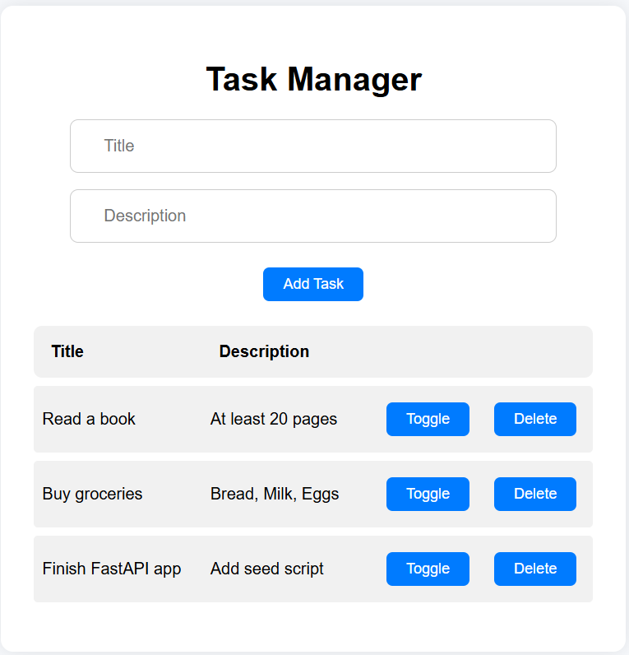
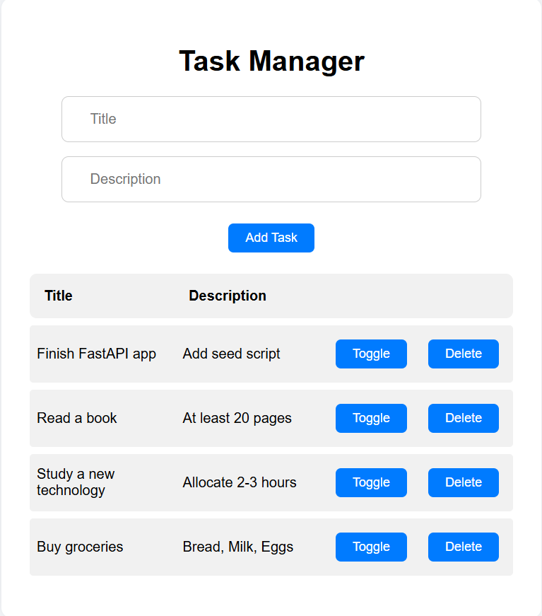
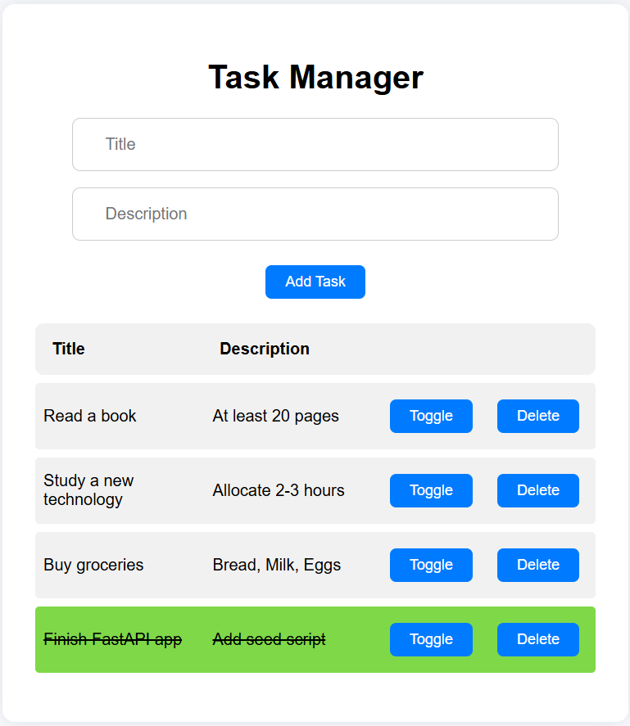
Demo
1. Initial
2. Add new task
3. Toggle task completed

Slide 6
Improvements for a Real-World Production Scenario – Part 1
0. Architecture
split the backend into modules/services: In this assessment, everything is bundled into a single FastAPI service. In a real-world app, I’d introduce clear separation (e.g., services, repositories, schemas, routes) or consider moving toward a microservice or modular monolith architecture if complexity grows.
1. Tooling
use environment variables properly: Instead of hardcoding DB credentials, I’d use a .env file and something like python-dotenv to load them safely.
testing setup: I would add unit and integration tests using pytest, including mock DB sessions and test coverage reports.
2. Frontend Approach
component structure: I would split the React app into smaller components (e.g., TaskForm, TaskItem, TaskList) to improve readability and reusability.
React Query: Instead of manually using axios in useEffect, I’d use React Query to manage data fetching, caching, and syncing automatically.

Slide 7
Improvements for a Real-World Production Scenario – Part 2
3. Docker & Deployment
production-ready Docker setup
multi-stage Docker builds to reduce image size.
separate docker-compose.dev.yml and docker-compose.prod.yml files.
Reverse proxy & HTTPS: I’d place FastAPI behind a reverse proxy like NGINX with HTTPS support (via Let’s Encrypt).
CI/CD pipeline: Add automated deployment using GitHub Actions or GitLab CI for linting, testing, building, and deploying the app.

Slide 8
Contact
Email: andrei.ilca97@gmail.com

